Slide 1
Research Administrators……….
Synergy in Support: Stronger Together

Slide 2
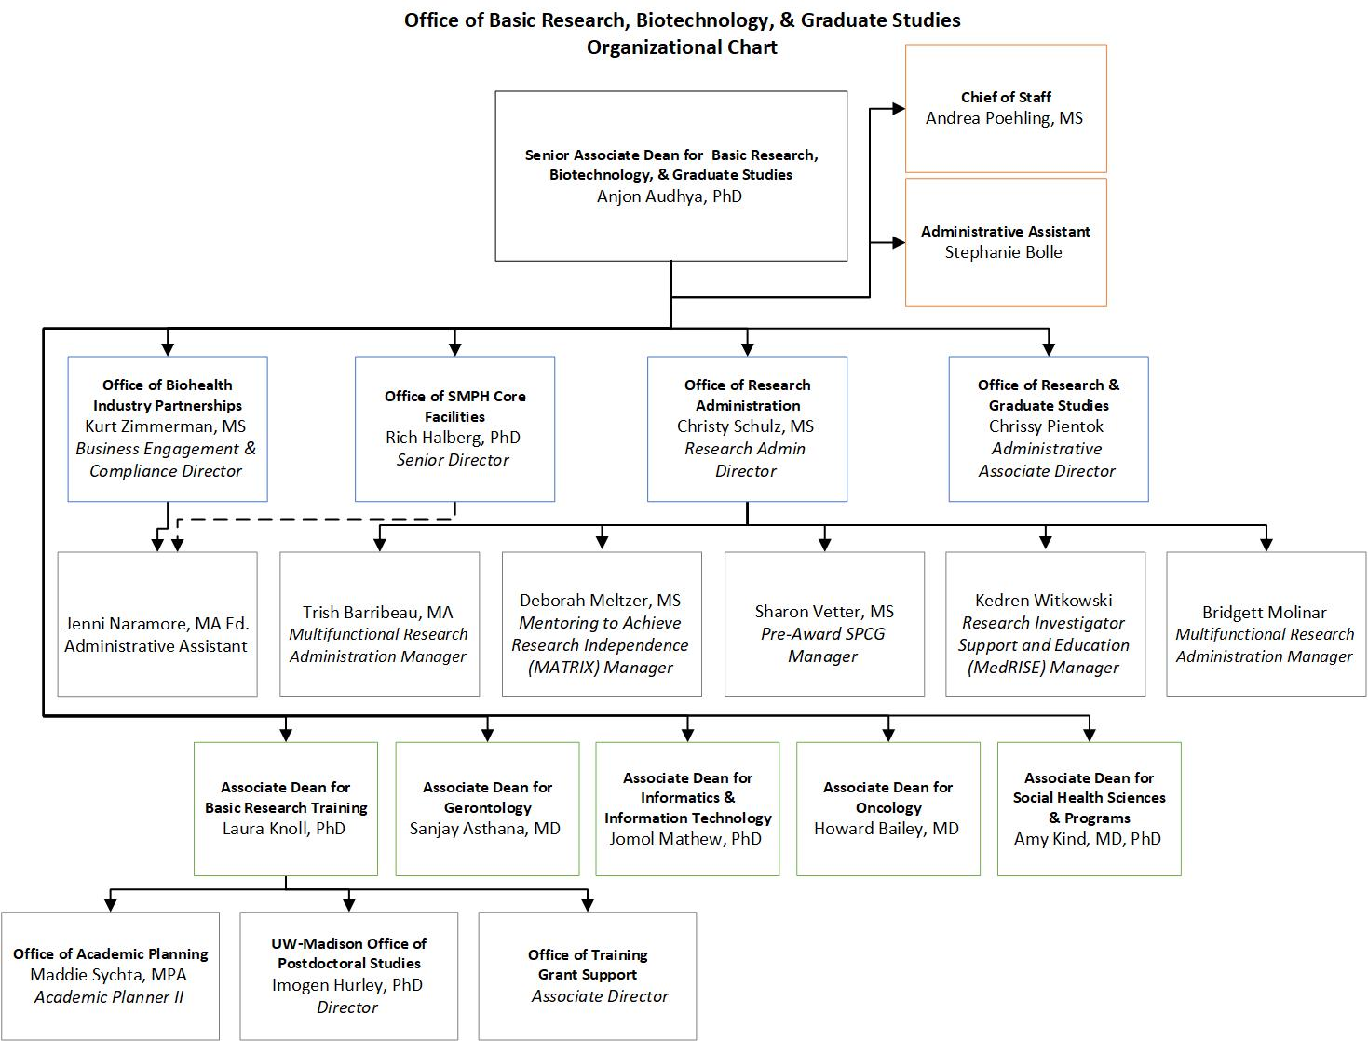

Slide 3
Research Administration
Provide expertise and assistance to investigators to advance exploration and knowledge at the UW
Protect the university by assuring compliance with sponsor guidelines and expectations
Provide appropriate stewardship of university resources
As Research Administrators we promote and facilitate the research, education, and outreach missions of the University of Wisconsin-Madison, School of Medicine and Public Health, by supporting and administering extramurally sponsored research.
Research Administration

Slide 4
medRISE (Research Investigator Support and Education)
Comprehensive proposal development support to alleviate the burdens on Principal Investigators, collaborators, and administrators throughout the grant application journey
Budget Development
Compliance Assistance
Project Management
Review and Editing
Proposal Compilation
medRISE Grants Library Repository
Interim departmental research administration support
medRISE

Slide 5
MATRIX (Mentoring to Achieve Research Independence)
Mentoring to Achieve Research Independence (MATRIX) is an intensive 9-month mentoring program coordinated by the School of Medicine and Public Health (SMPH) and designed to help faculty members (mentees) successfully land their first National Institute of Health (NIH) R01 Research Project Grant or equivalent.
MATRIX

