Slide 1
NIH Funding Snapshot - SMPH

Slide 2
Goal – Assess strengths, weaknesses, opportunities for NIH funding at SMPH

Slide 3
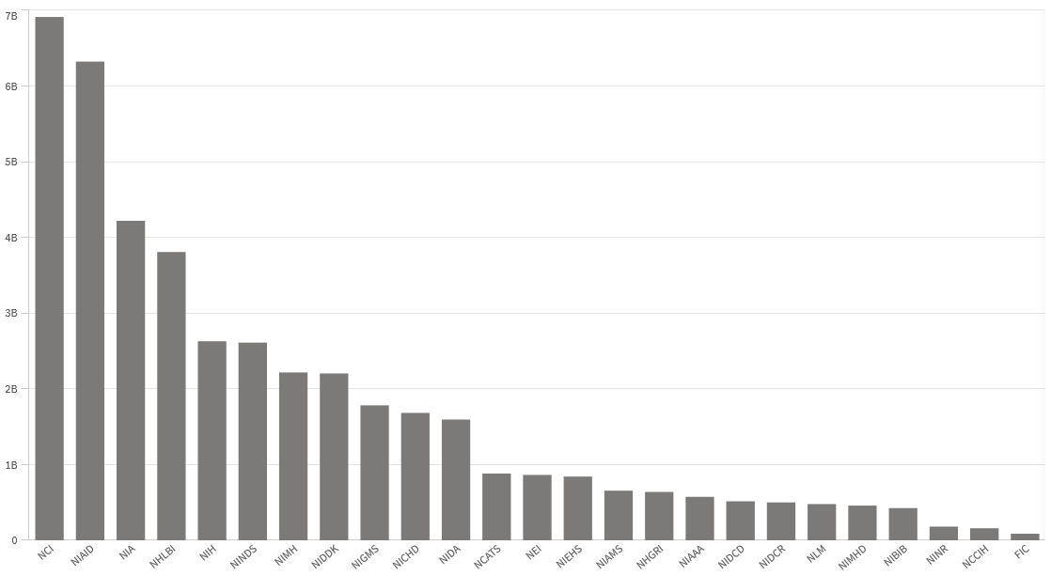
NIH Funding across its 25 Institutes in $ (FY22)

Slide 4
Comparison/Peer Institutions
(schools of medicine and public health)
Pittsburgh - #6 (675 tenure-track faculty)
Michigan - #14 (883 TT faculty)
Northwestern - #16 (387 TT faculty)
Minnesota - #21 (436 TT faculty)
UW-Madison - #28 (461 TT faculty)
2022 BRIMR Rankings

Slide 5
Total Funding from NIH Institutes, FY 22
#6
School | Total $ Amount of Funding
UW MADISON | $184,413,732
MICHIGAN | $330,997,064
MINNESOTA | $193,214,455
NORTHWESTERN | $260,184,930
PITTSBURGH | $397,126,544
#14
#16
#28
#21
(461)
(883)
(436)
(387)
(675)
Data from NIH Reporter Website

Slide 6
Total Funding from NIH Institutes, FY 22
School | Total $ Amount of Funding
UW MADISON | $184,413,732
MICHIGAN | $330,997,064
MINNESOTA | $193,214,455
NORTHWESTERN | $260,184,930
PITTSBURGH | $397,126,544
#4
(461)
(883)
(436)
(387)
(675)
Data from NIH Reporter Website

Slide 7
UW-Madison Normalized Ranking at each Institute in $ (FY22)
#2
#3
Pittsburgh - #6 (675)
Michigan - #14 (883)
Northwestern - #16 (387)
Minnesota - #21 (436)
U W-Madison - #28 (461)
#3
#5
(UW-1 grant)
#1
#5
#5
#5
#1
#2
#5
#3
#1
- Last
#5
#5
#4
#5
#2
#2
#4
#5
#3
#3
#5
#5

Slide 8
National Cancer Institute (NCI)

Slide 9
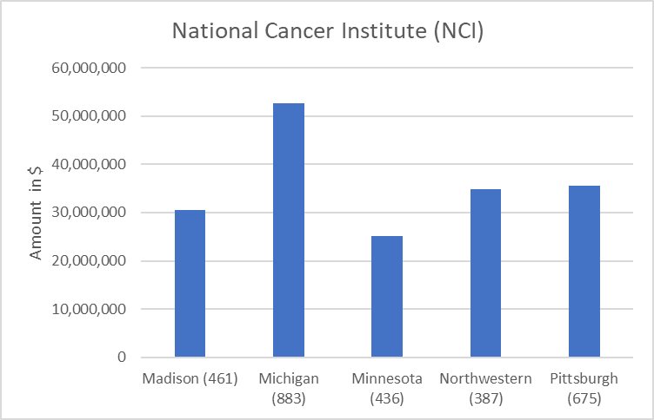
Total NCI Funding by School, FY 22
Rank:
#4
68 | 142 | 72 | 103 | 111 | # PIs with grants

Slide 10
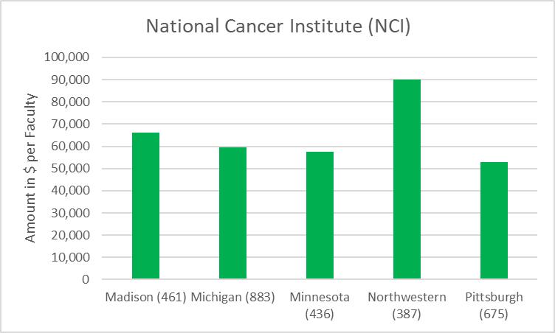
NCI Funding Normalized to # of Tenure Track Faculty
Rank:
#2

Slide 11
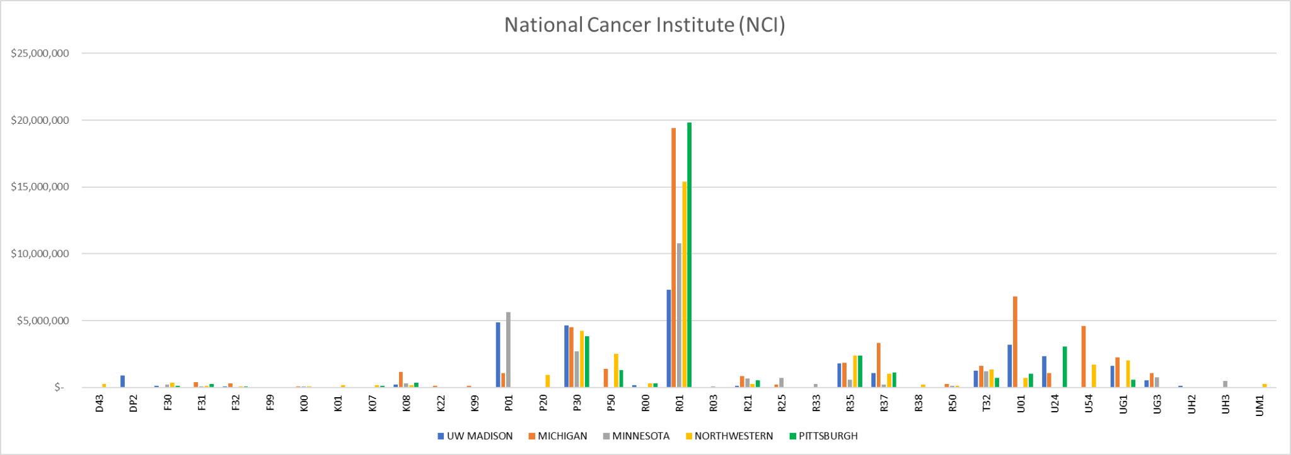
Funded Grants by School

Slide 12
National Institute of Allergy and Infectious Diseases Extramural Activities (NIAID)

Slide 13
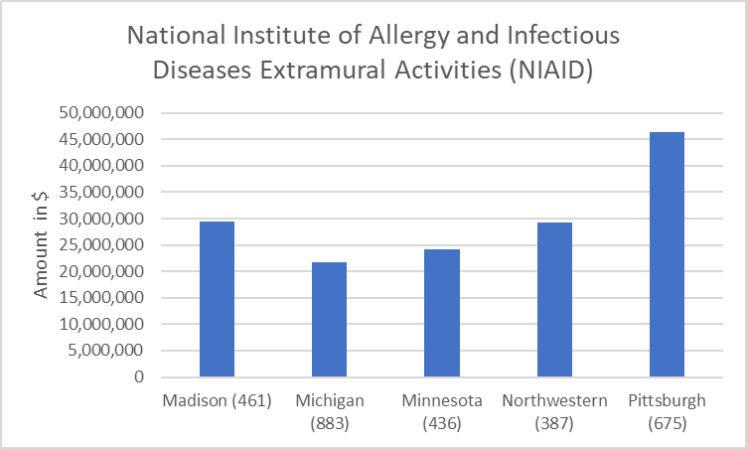
Total NIAID Funding by School, FY 22
Rank: #2
57 | 68 | 67 | 66 | 117 | # PIs with grants

Slide 14
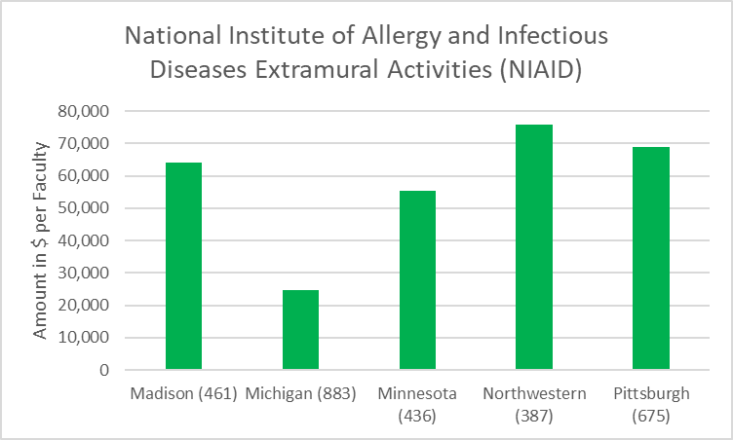
NIAID Funding Normalized to # of Tenure Track Faculty
Rank: #3

Slide 15
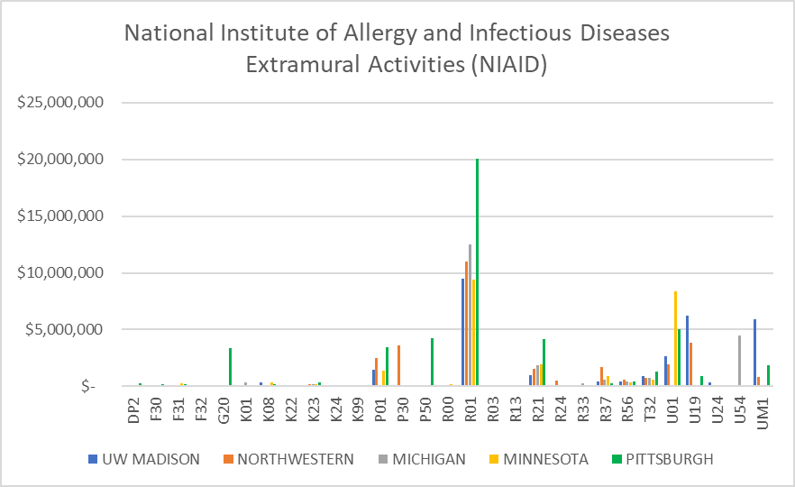
Funded Grants by School

Slide 16
National Heart, Lung, and Blood Institute (NHLBI)

Slide 17
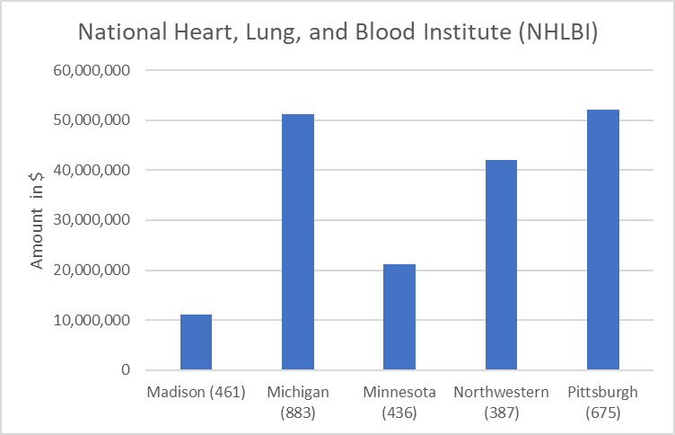
Total NHLBI Funding by School, FY 22
Rank:
#5
35 | 135 | 60 | 93 | 160 | # PIs with grants

Slide 18
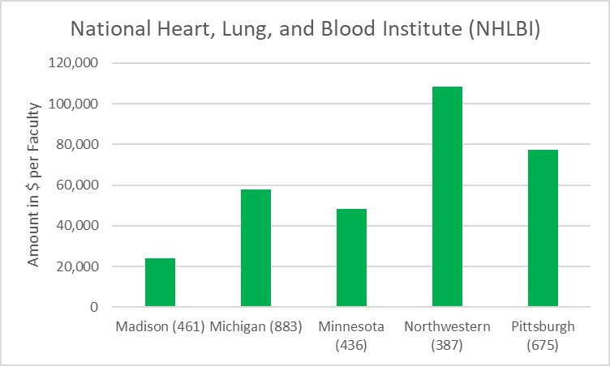
NHLBI Funding Normalized to # of Tenure Track Faculty
Rank:
#5

Slide 19
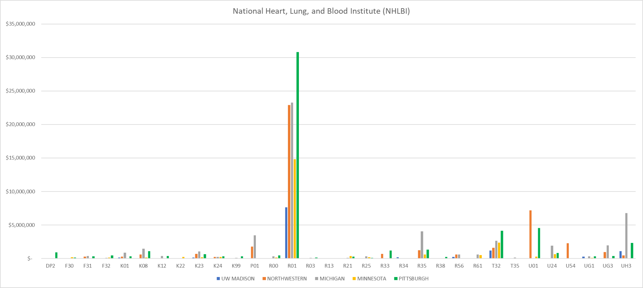
Funded Grants by School

Slide 20
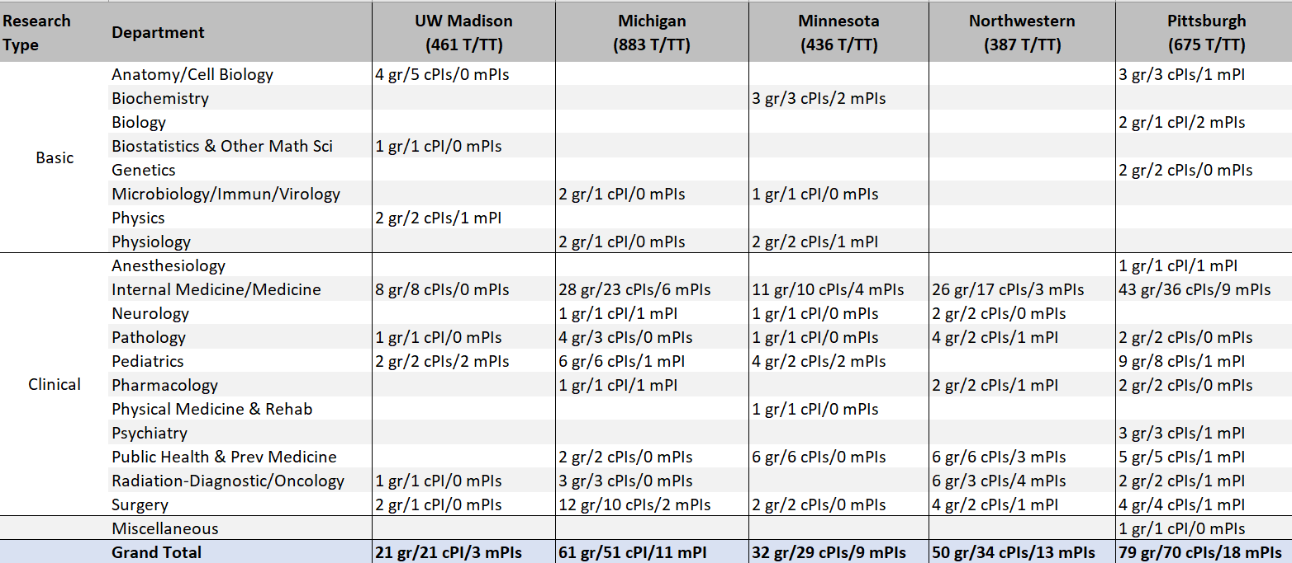
Summary of PIs with RO1s Funded by NHLBI

Slide 21
National Institute of Diabetes and Digestive and Kidney Diseases (NIDDK)

Slide 22
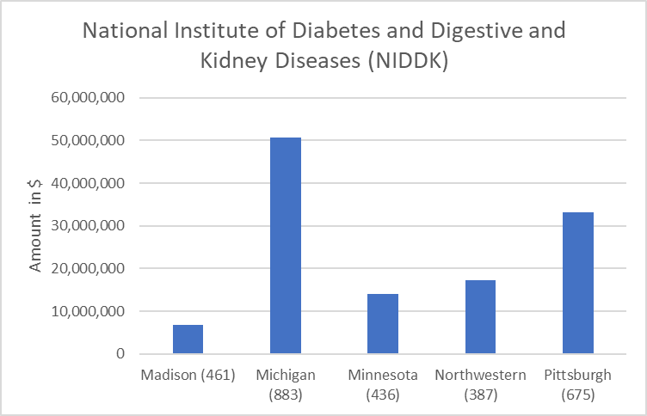
Total NIDDK Funding by School, FY 22
Rank:
#5
26 | 146 | 49 | 58 | 122 | # PIs with grants

Slide 23
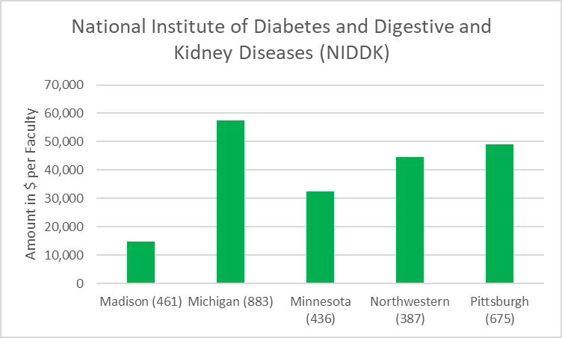
NIDDK Funding Normalized to # of Tenure Track Faculty
Rank:
#5

Slide 24
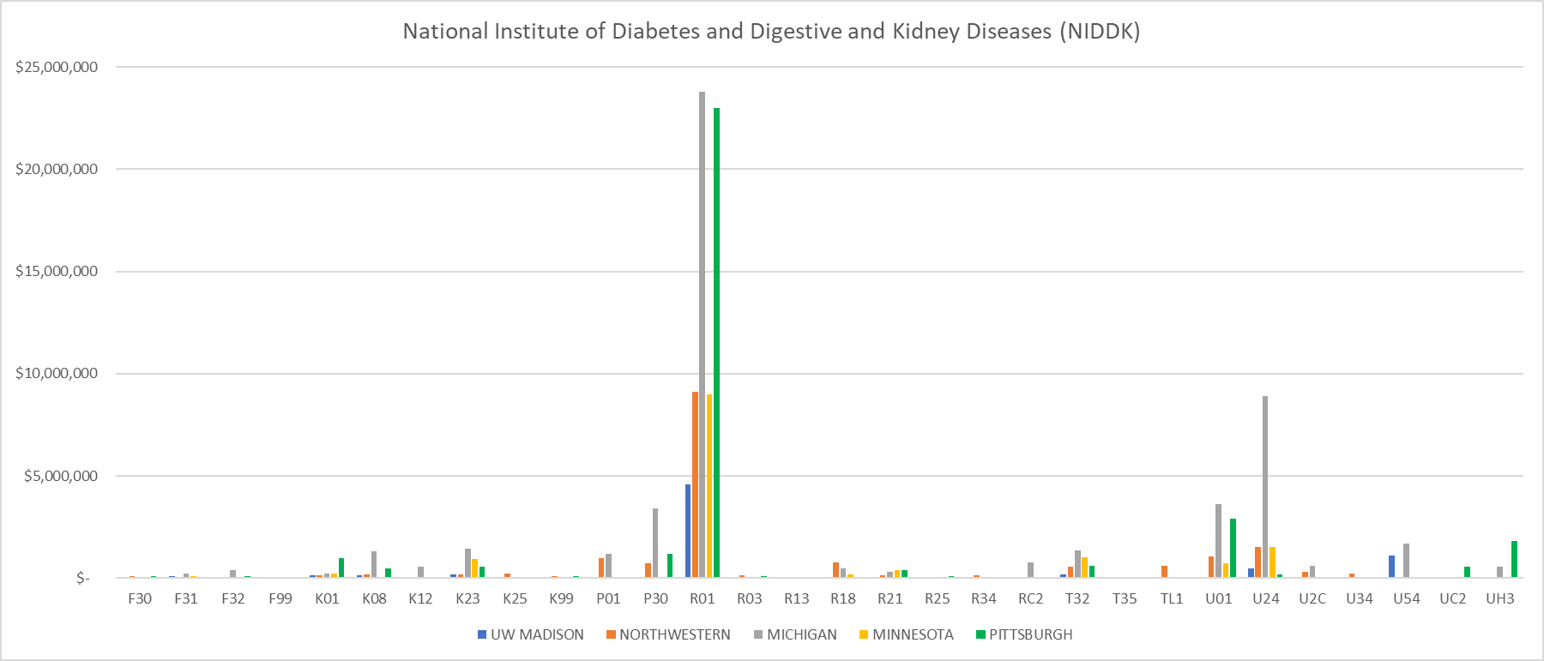
Funded Grants by School

Slide 25
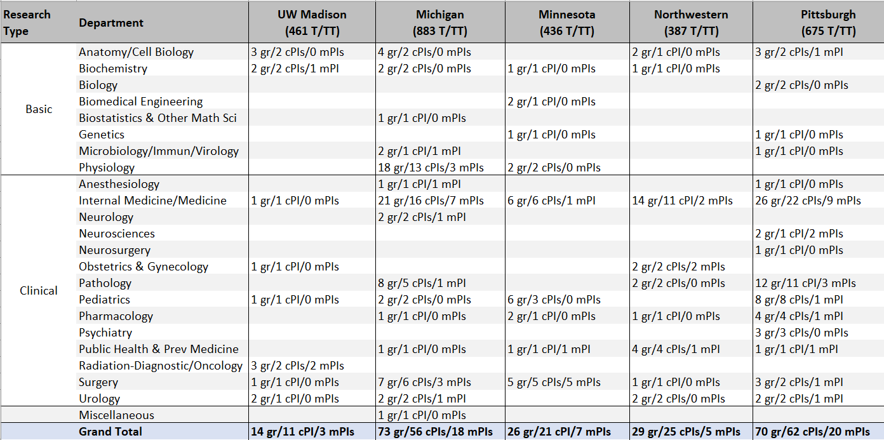
Summary of PIs with RO1s Funded by NIDDK

Slide 26
Overall picture
School | Total # NIH grants | Total # R01/R35s | R01s/TT faculty | Total # F awards | Total # non-R01s/non-Fs | %TT
UW-Madison | 409 | 218 | 47% | 30 | 161 | 35%
Michigan | 986 | 504 | 57% | 88 | 439 | 45%
Minnesota | 560 | 305 | 70% | 43 | 212 | 50%
Northwestern | 655 | 364 | 94% | 49 | 242 | 62%
Pittsburgh | 1011 | 545 | 81% | 65 | 401 | 61%
#28
461 TT
#14
883 TT
#21
436 TT
#16
387 TT
#6
675 TT

Slide 27
Overall picture
School | Total # NIH grants | Total # R01/R35s | R01s/TT faculty | Total # F awards | Total # non-R01s/non-Fs | %TT
UW-Madison | 409 | 218 | 47% | 30 | 161 | 35%
Michigan | 986 | 504 | 57% | 88 | 439 | 45%
Minnesota | 560 | 305 | 70% | 43 | 212 | 50%
Northwestern | 655 | 364 | 94% | 49 | 242 | 62%
Pittsburgh | 1011 | 545 | 81% | 65 | 401 | 61%
Multi-PI
R01/R35s
#28
461 TT
18%
#14
883 TT
27%
#21
436 TT
29%
#16
387 TT
22%
#6
675 TT
28%

Slide 28
Thank you to Jenni Naramore!!!
For discussion – how could this data be useful?
- focus on institutes that are underutilized?
- means of encouraging or incentivizing submissions?
- are expectations appropriate?
- means of encouraging or incentivizing mPI awards?
- how to communicate results?
- next steps in collecting information?
- any interest in meeting to discuss in more detail?!

